Slide 1
Build a Watson AI Chatbot from Db2
Sanjula Ganepola, IBM
Software Developer
sanjula.ganepola@ibm.com

Slide 2
Agenda
Overview of Watsonx Assistant
Planning Your Assistant
Terminology You Should Know
Let’s Build a Chatbot
Integrate with Db2
Next Steps

Slide 3
Overview of Watsonx Assistant

Slide 4
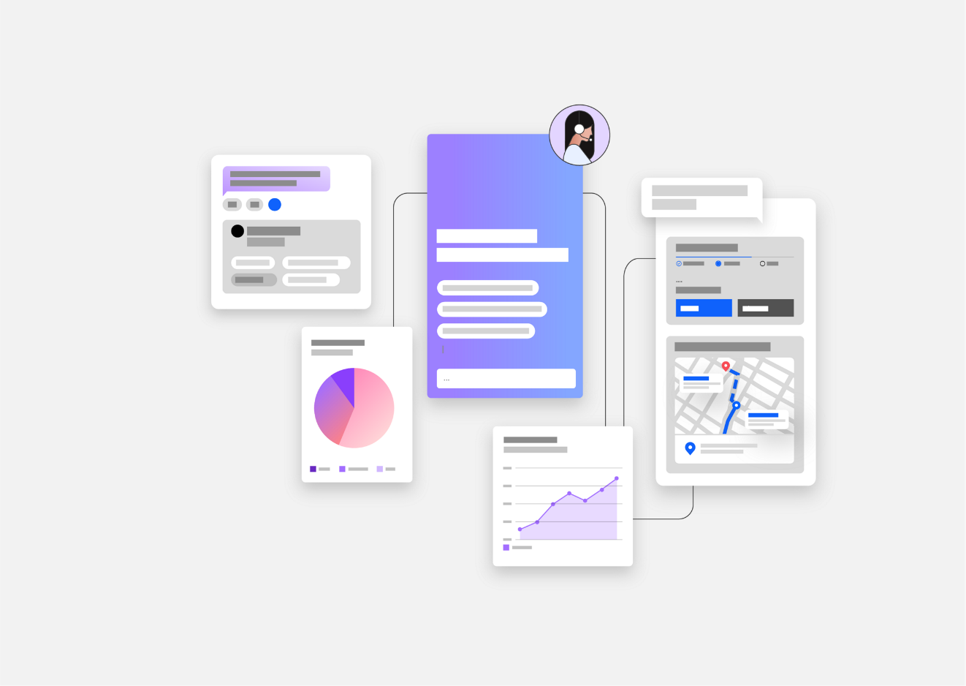
What is Watsonx Assistant?
“Conversational AI solution that empowers anyone to effortlessly build generative AI Assistants that deliver frictionless self-service experiences to customers”
↓
Use Watsonx Assistant to build your own branded live chatbot
💻 Bring the assistant to your customers, where they are
🧠 Create AI-driven conversational flows
📑 Embed existing help content
🤝 Connect to your customer service teams
🎯 Track customer engagement and satisfaction

Slide 5
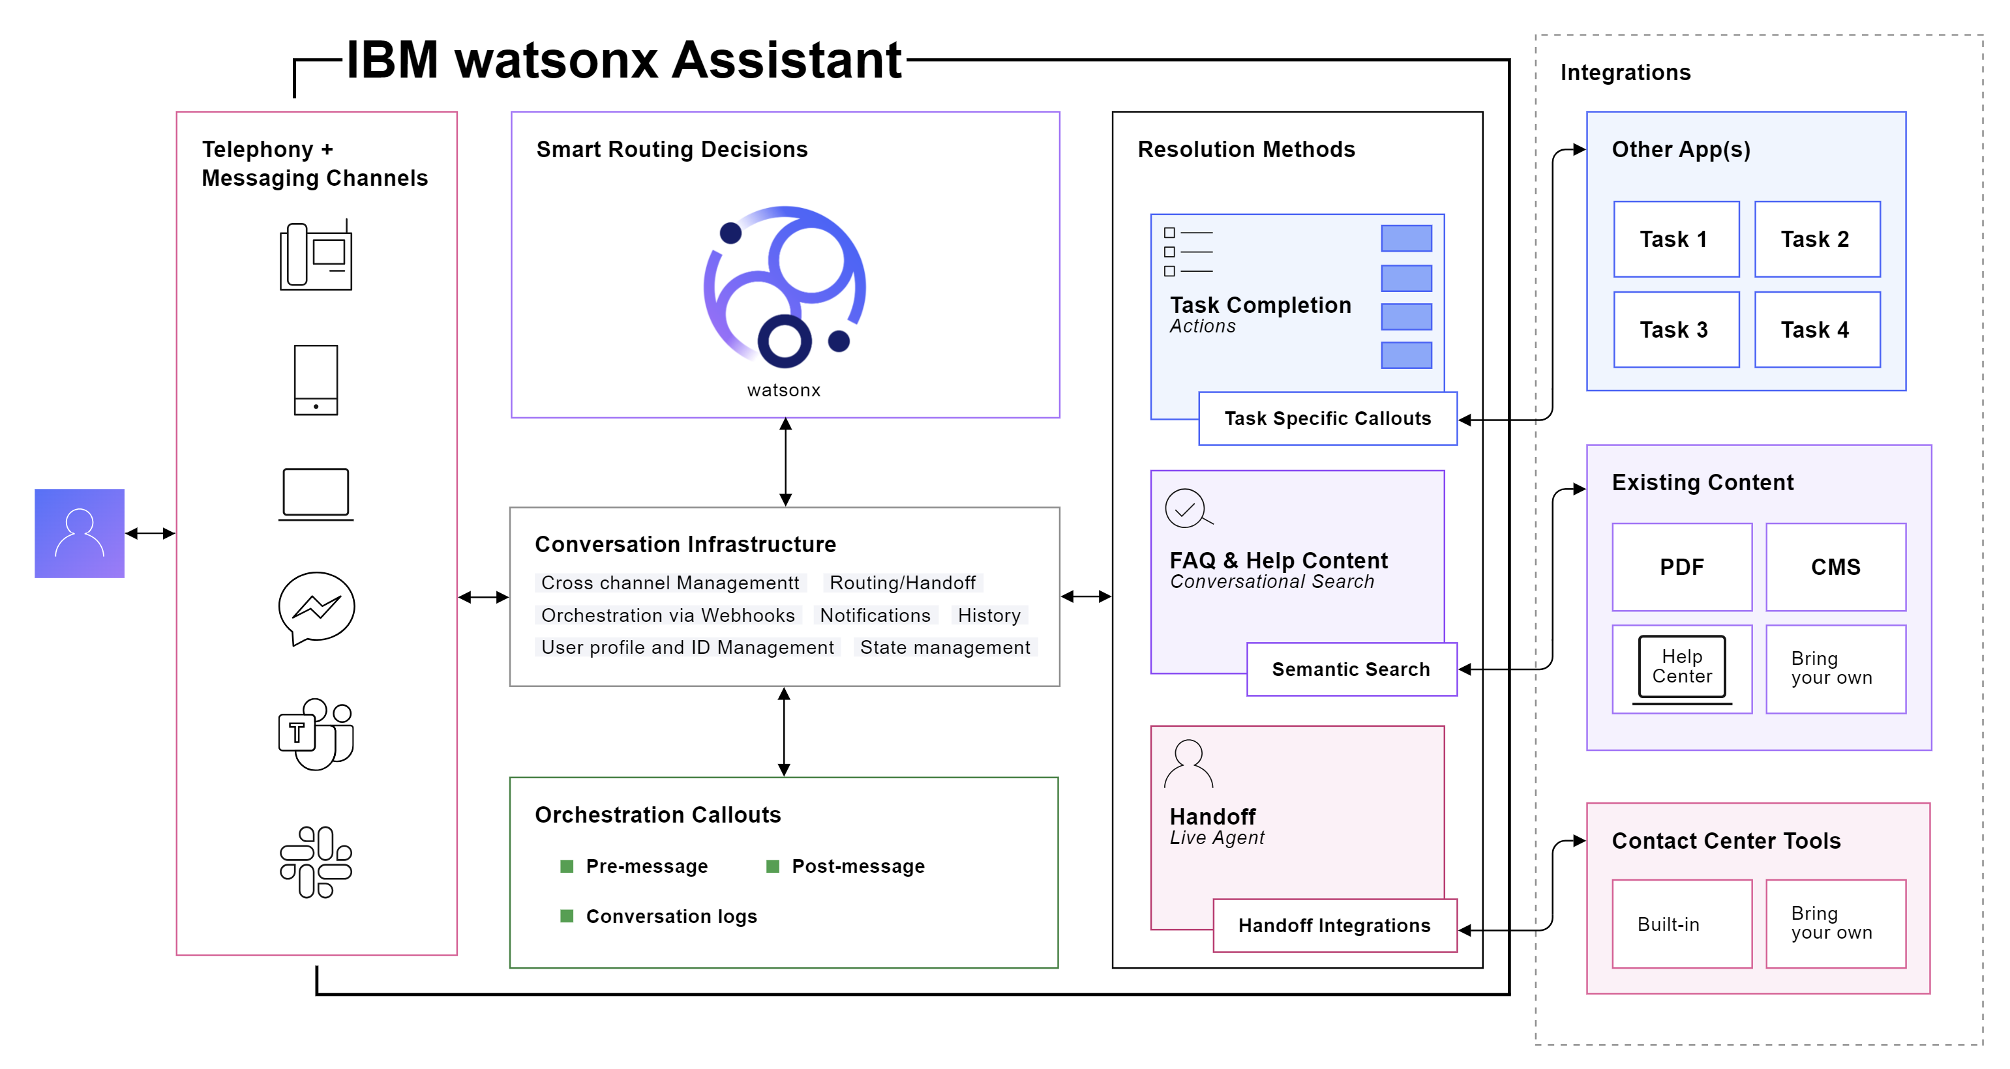
How Does It Work?

Slide 6
Planning Your Assistant

Slide 7
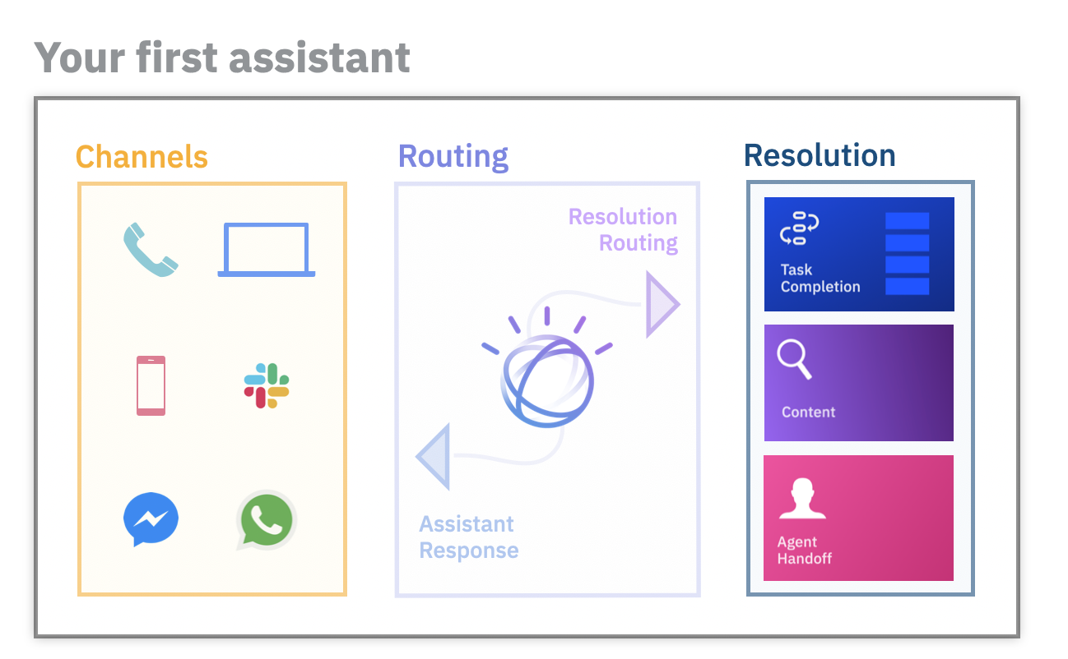
Before building an assistant…
Select an initial channel
Where will customers use your assistant?
Select starting domain
What topic domain can your assistant unify and automate?
Outline frequent topics
What are the most frequent topics which are mostly informational in nature?
Collect content sources
What help content is available to customers today?
Plan handoff strategy
How should customers be routed to human agents?

Slide 8
Terminology You Should Know

Slide 9
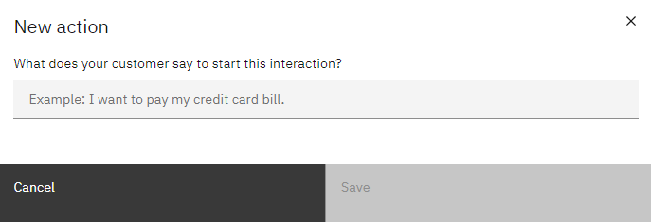
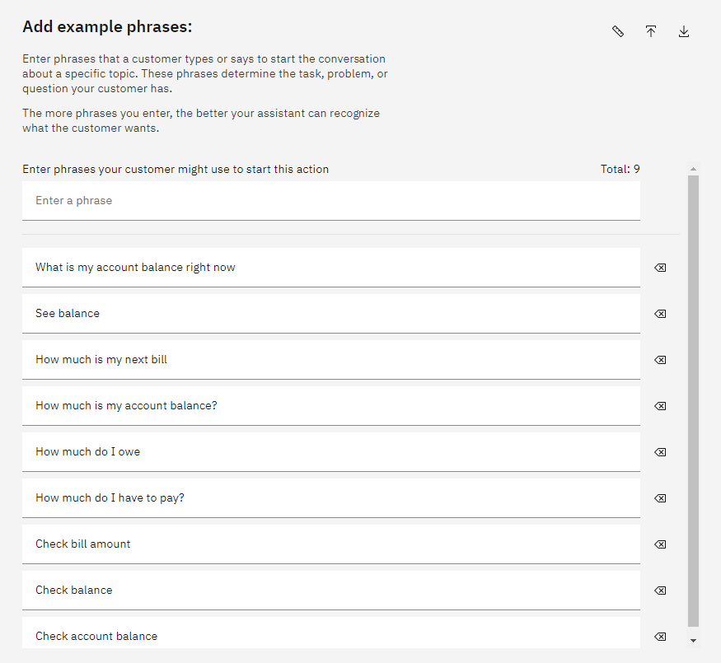
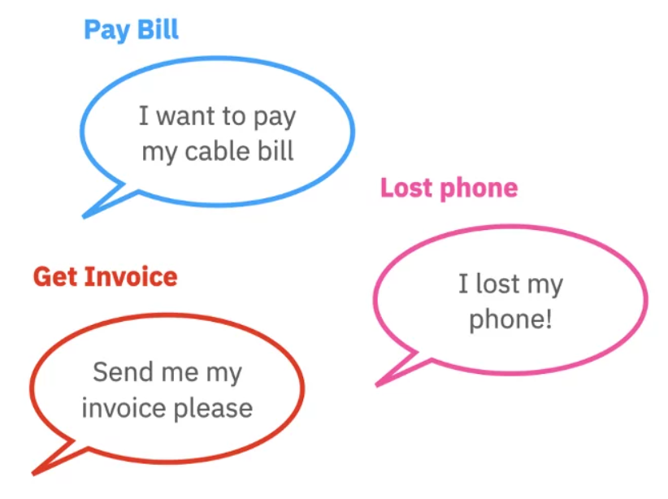
What are Actions and Phrases?
An action is a problem or a task that your customer wants to resolve
Phrases are what customers type or say to start an action
Add multiple phrases to better train your assistant to recognize what customers want

Slide 10
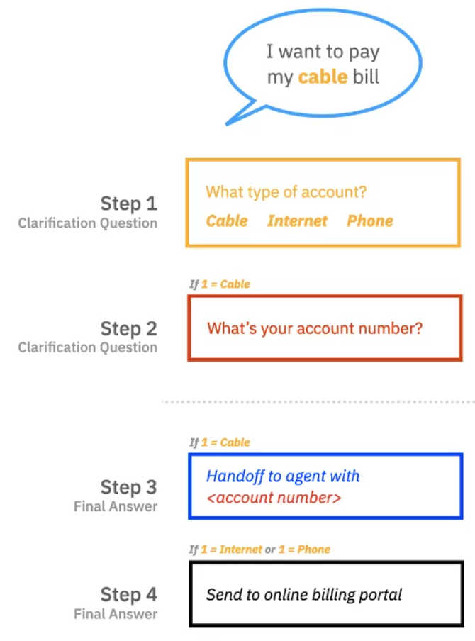
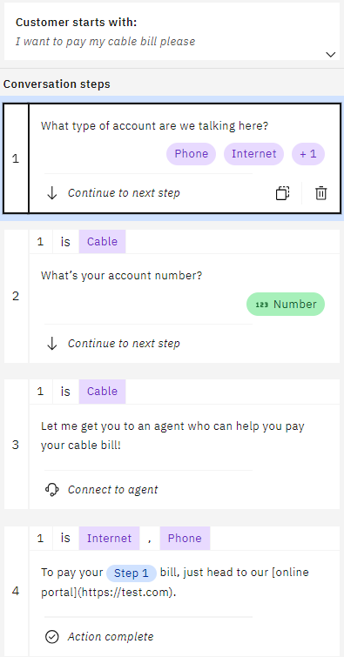
What are Steps and Conditions?
A step is a back-and-forth interaction between your assistant and your customer
Conditions are requirements which must be met for the step to be triggered

Slide 11
Let’s Build a Chatbot

Slide 12




Demo Example – ConnectMe Inc.
ConnectMe Inc. is a telecommunications company with cable, internet, and phone services
ConnectMe Inc.
Goals
Streamline bill payment services
Update account data in real-time
Provide 24/7 support
Customer A
Support Rep A
Database
Customer B
Support Rep B
FAQ Manual

Slide 13
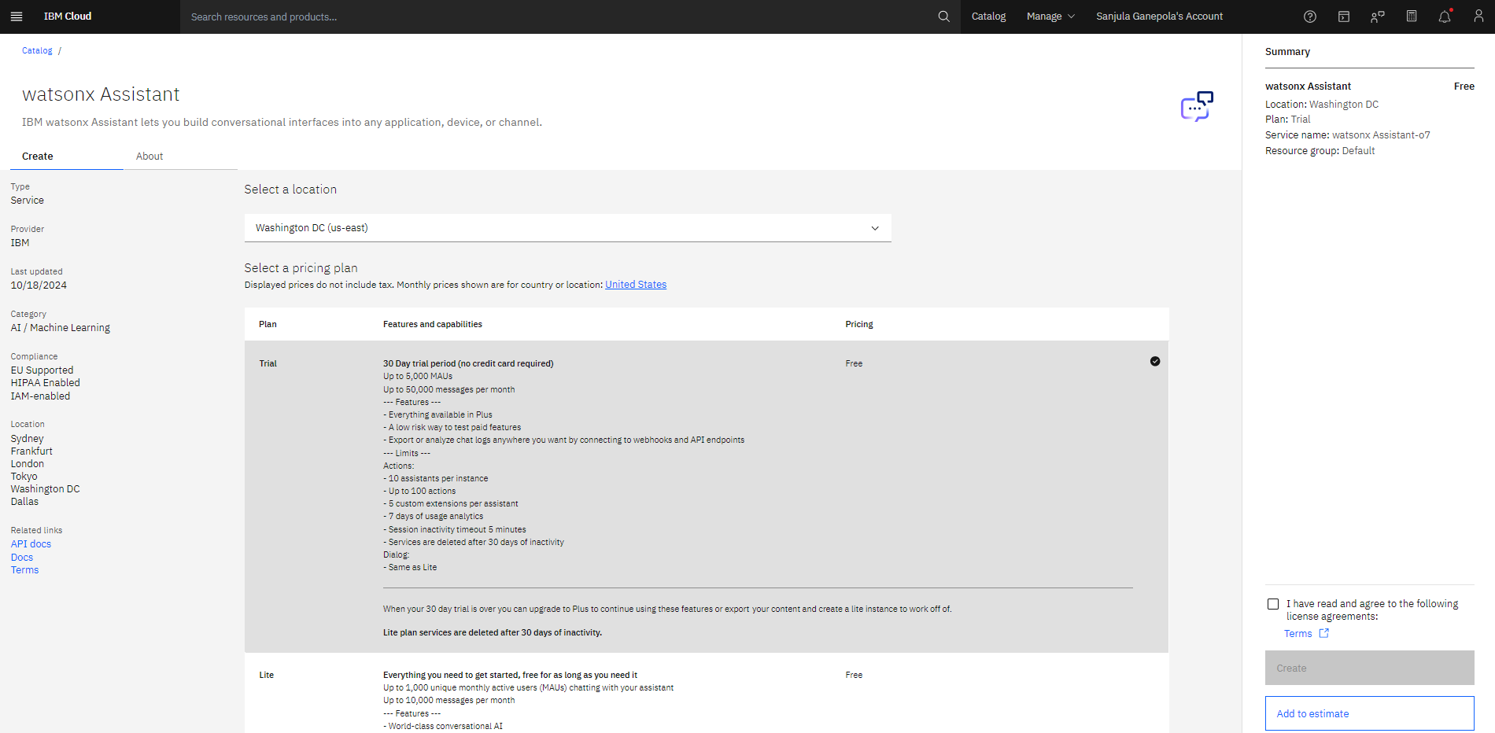
Create Watsonx Assistant Instance

Slide 14
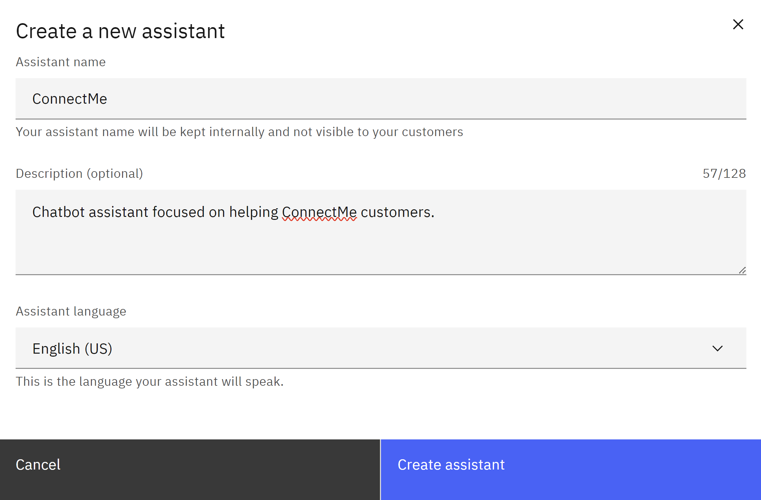
Create Watsonx Assistant

Slide 15
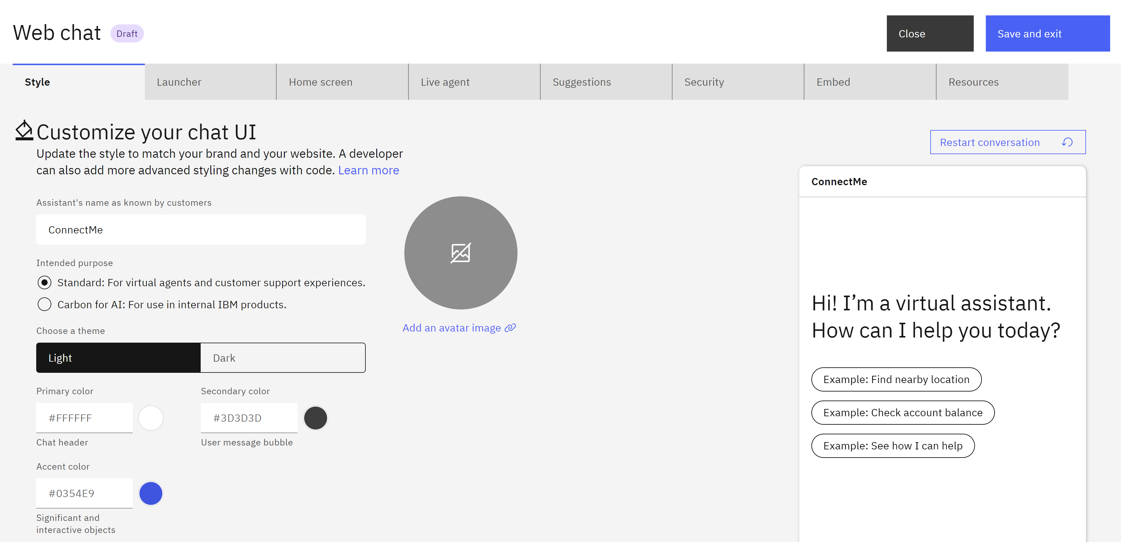
Customize Web Chat

Slide 16
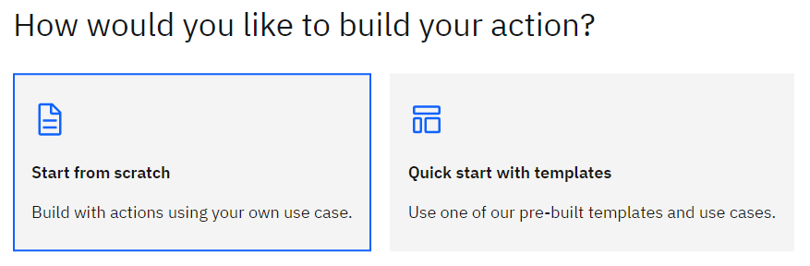
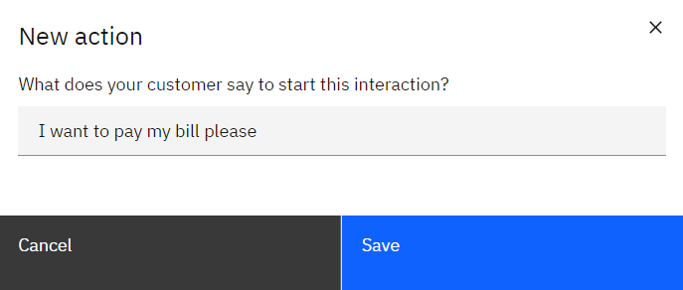
Create Action From Scratch and Set Initial Phrase

Slide 17
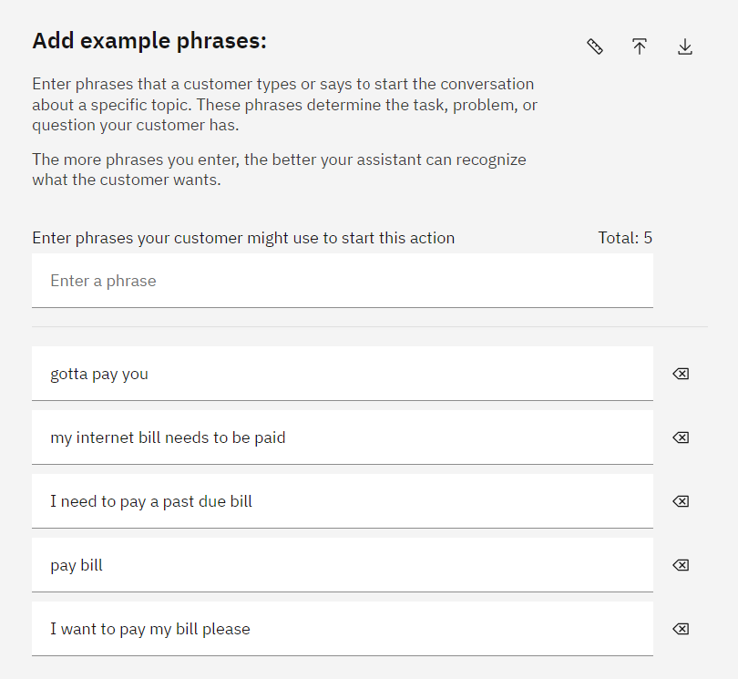
Add More Example Phrases
⭐

Slide 18
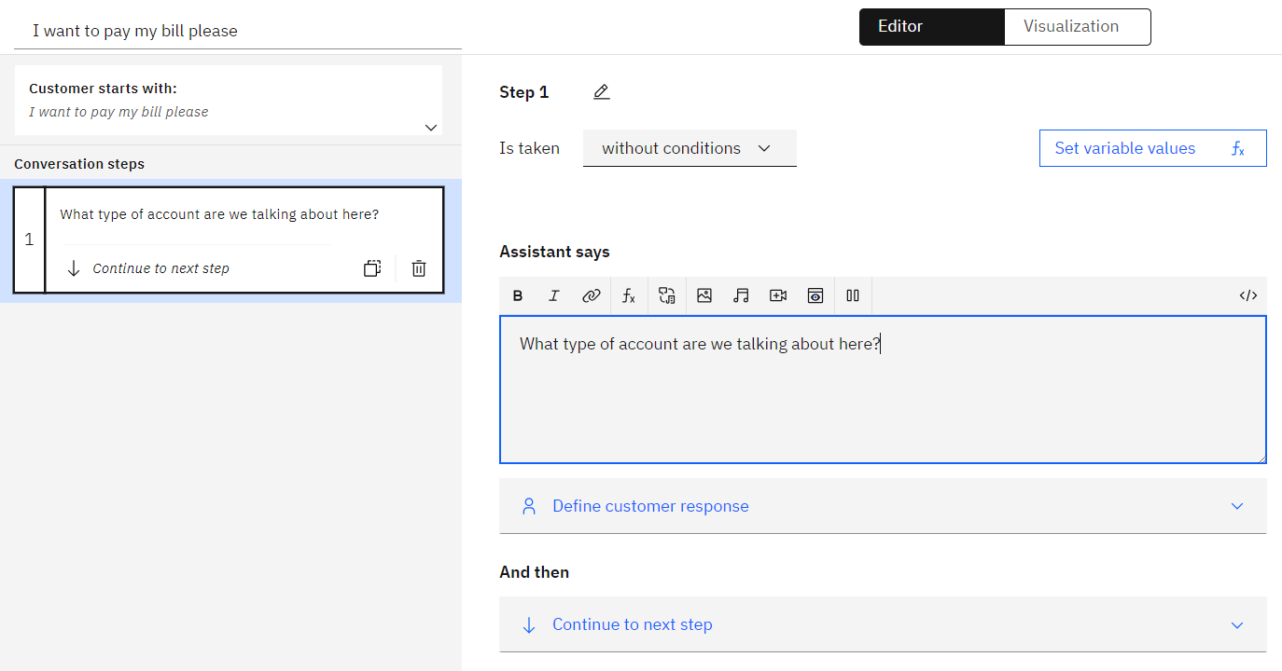
Create First Step

Slide 19
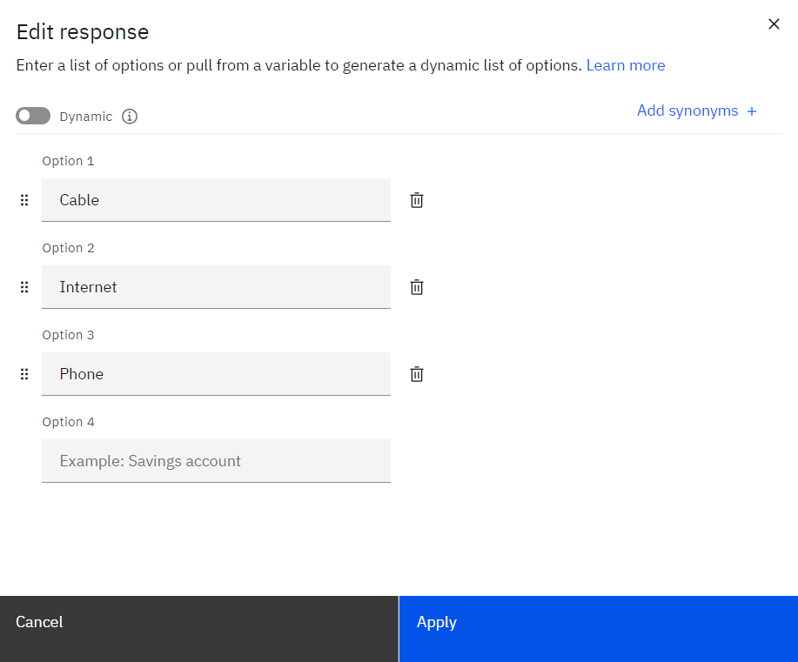
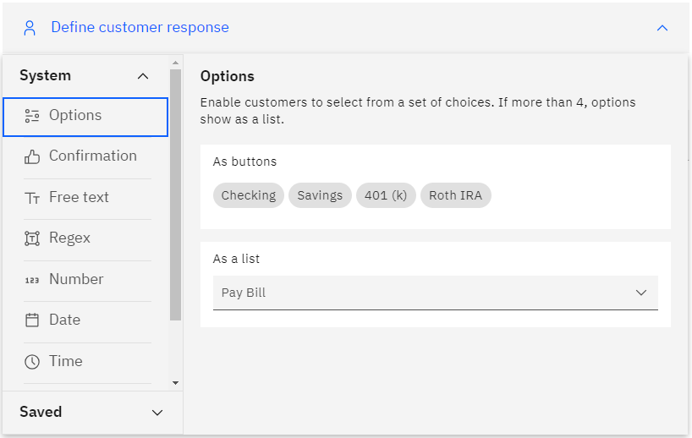
Add Custom Response Options

Slide 20
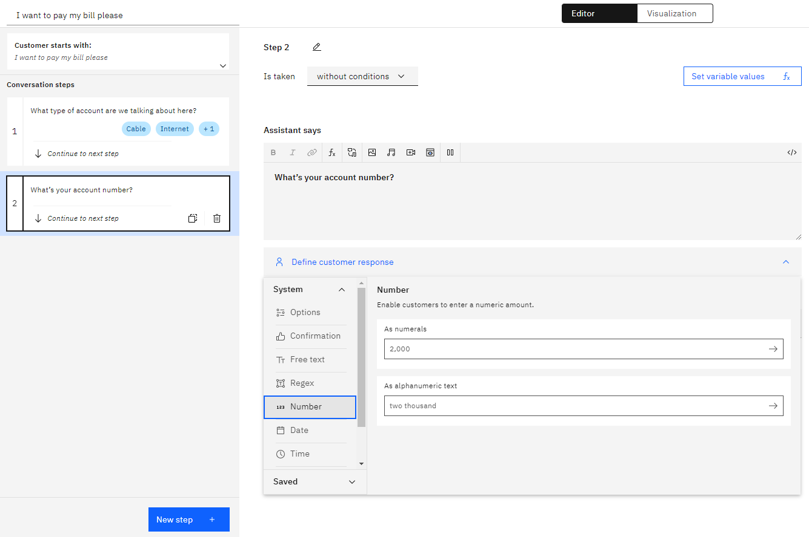
Create Another Clarification Step

Slide 21
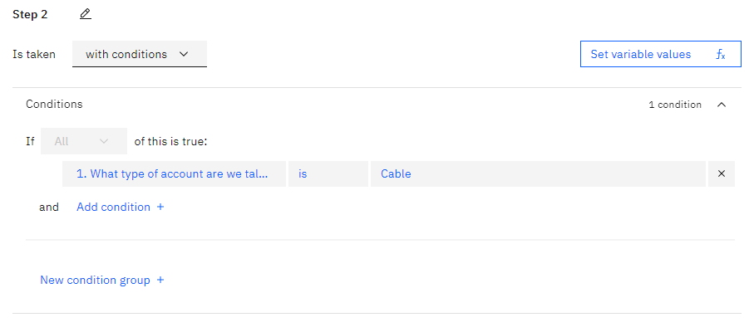
Add Condition

Slide 22
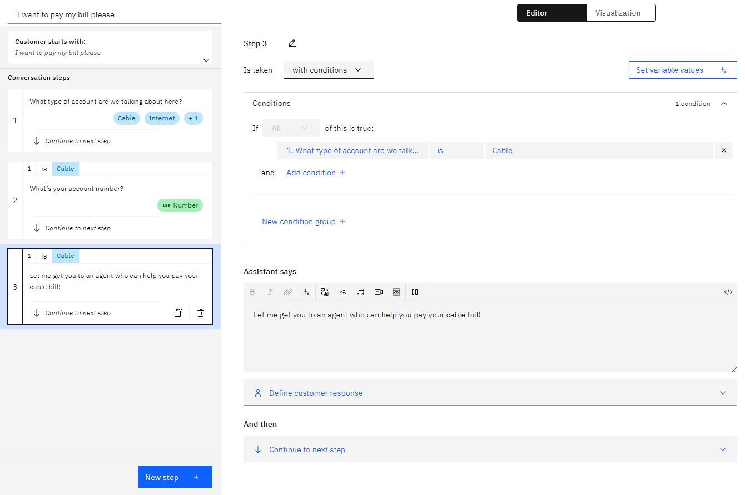
Create an Agent Handoff Step

Slide 23
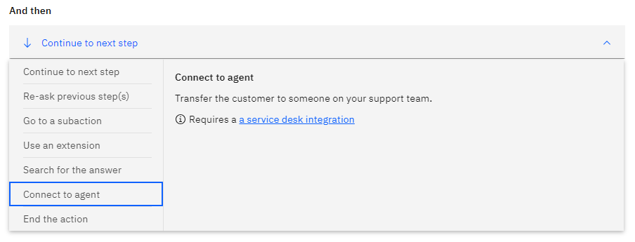
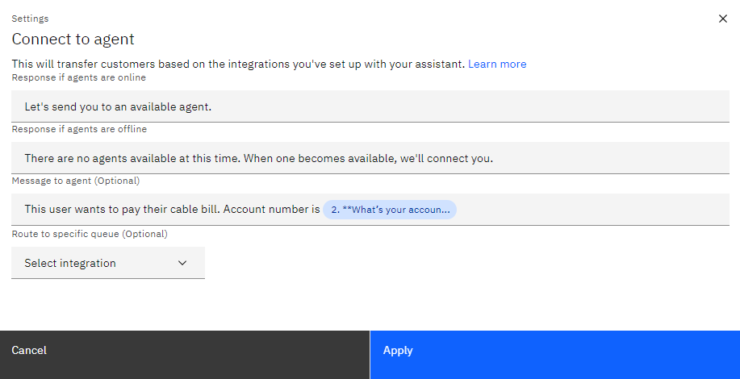
Connect to Agent

Slide 24
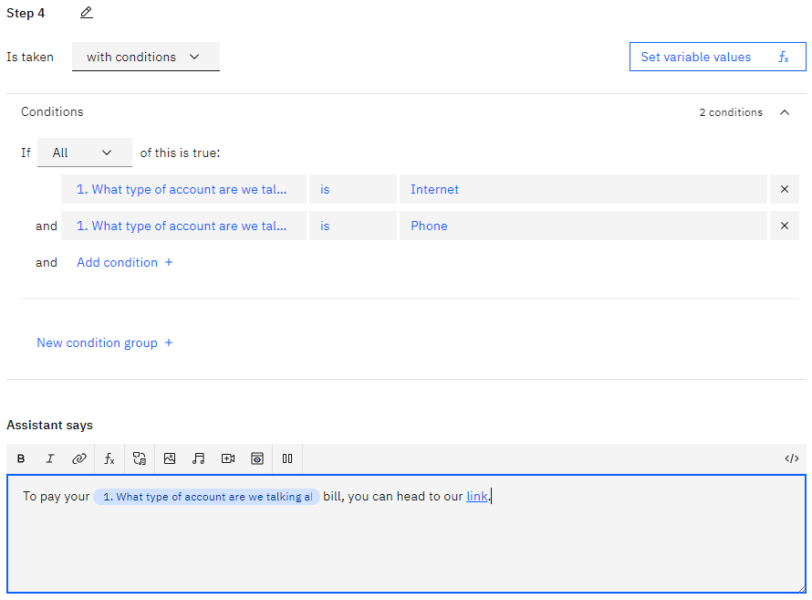
Create Final Response Step

Slide 25
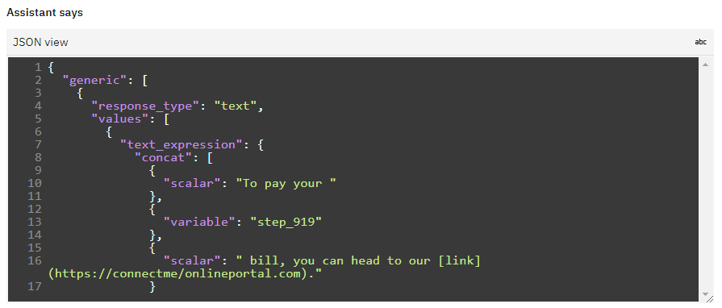
Edit Response in JSON View

Slide 26
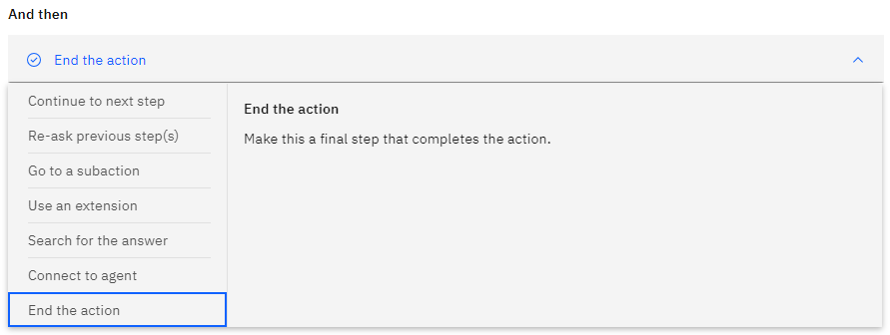
End the Action

Slide 27
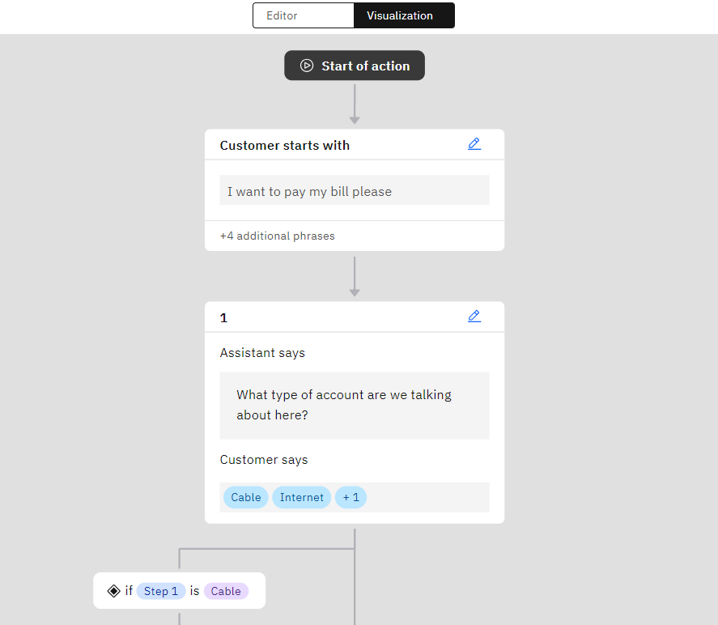
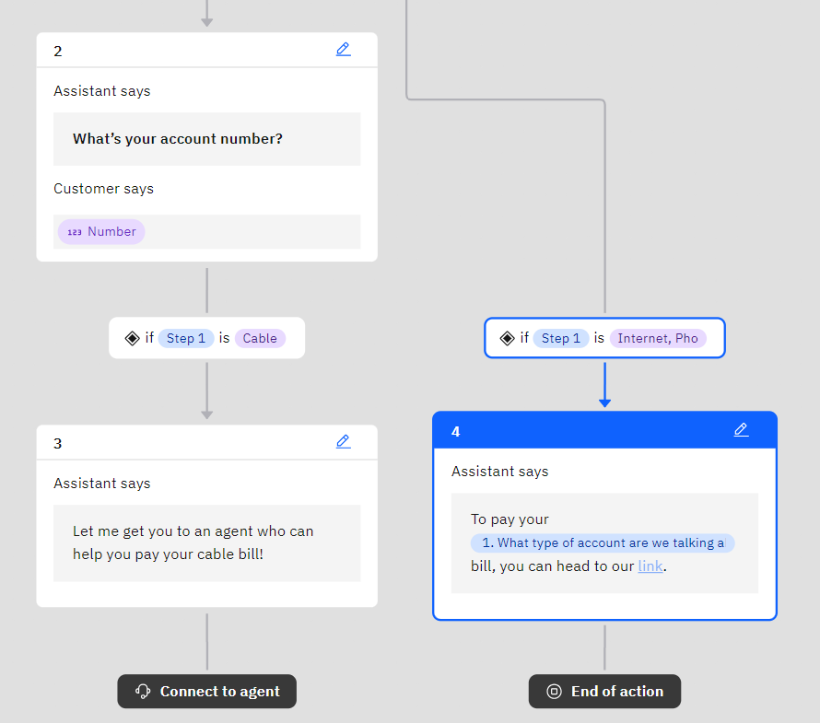
Use Visualization Tool

Slide 28
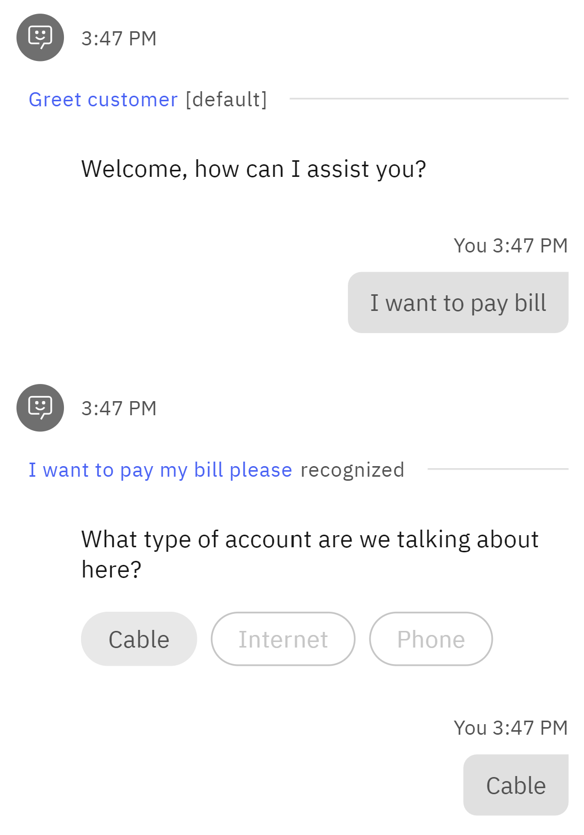
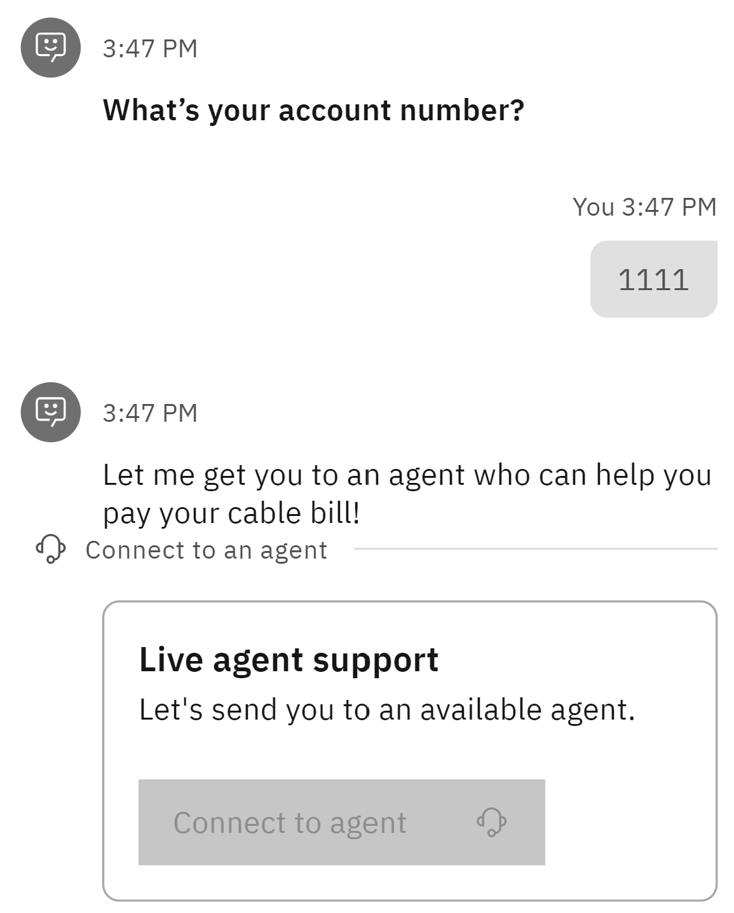
Preview Your Action

Slide 29
Integrate with Db2

Slide 30
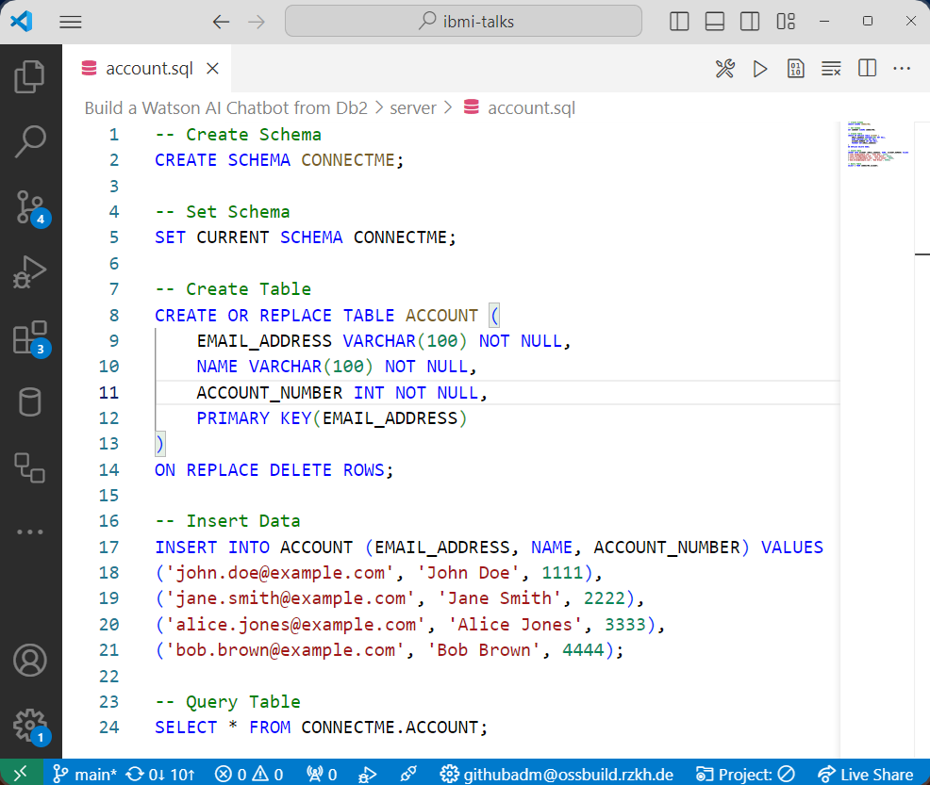
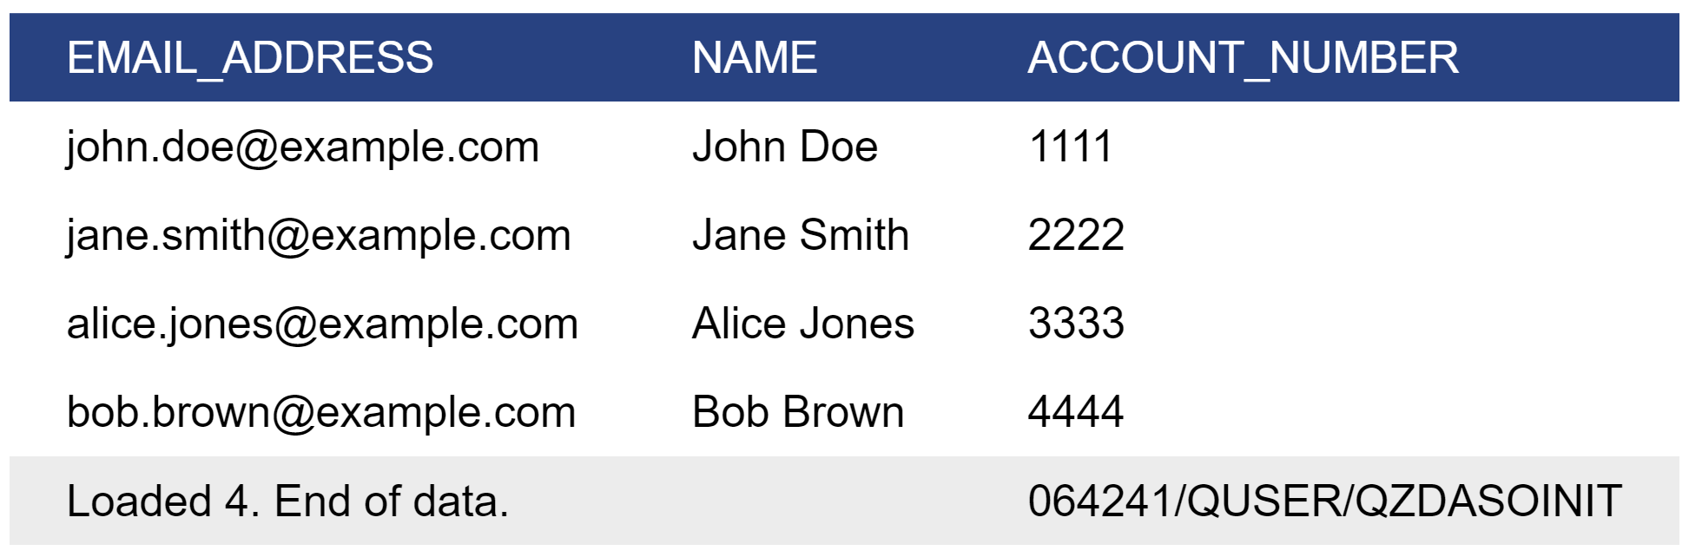
Create Table

Slide 31
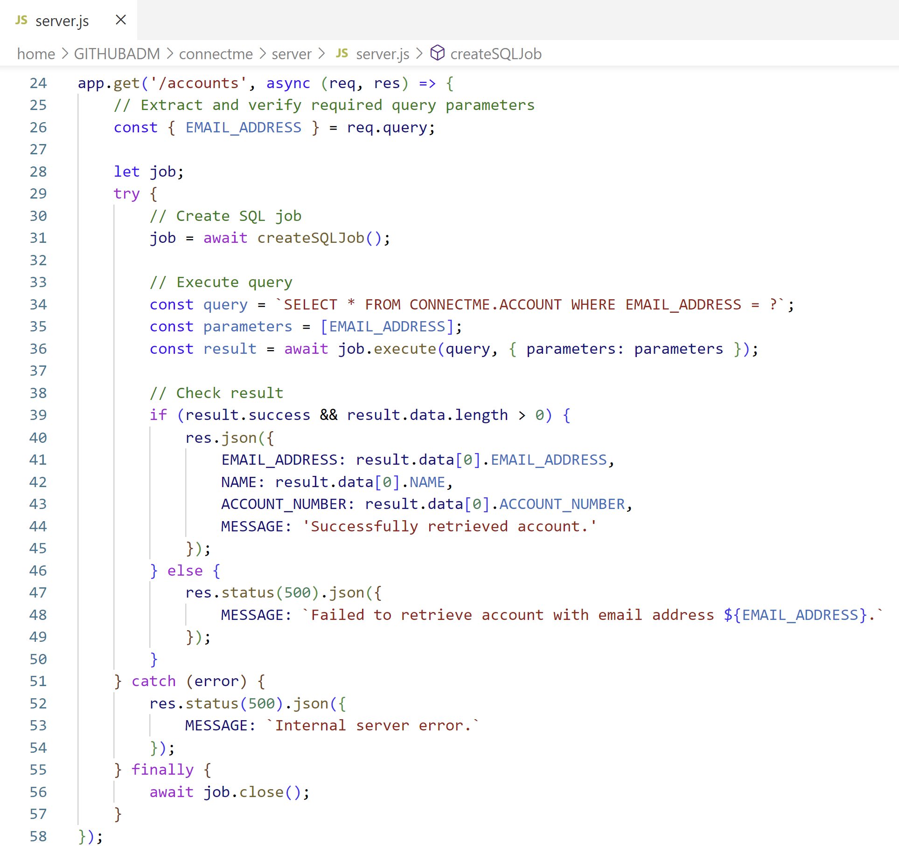
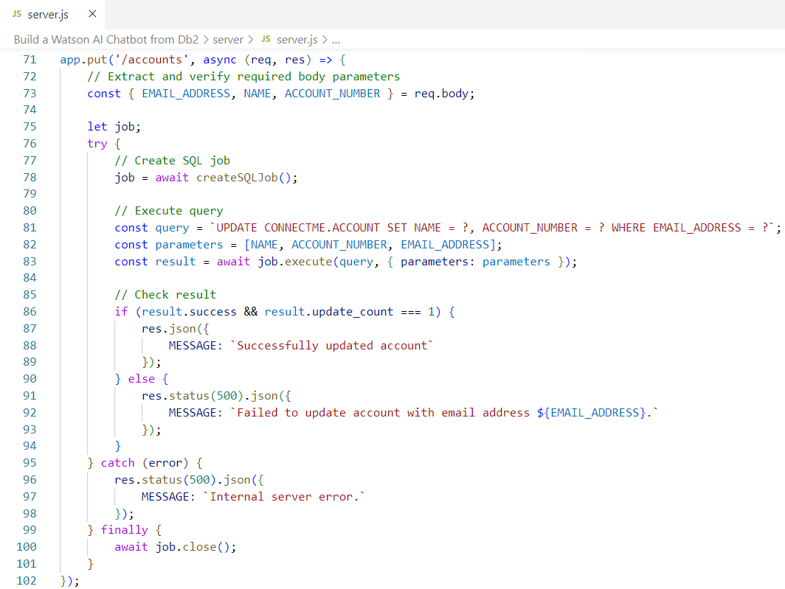
Create REST Server
👨🏻‍💻Server Source Code: server.js
SELECT * FROM CONNECTME.ACCOUNT WHERE EMAIL_ADDRESS = ?
UPDATE CONNECTME.ACCOUNT SET NAME = ?, ACCOUNT_NUMBER = ? WHERE EMAIL_ADDRESS = ?

Slide 32
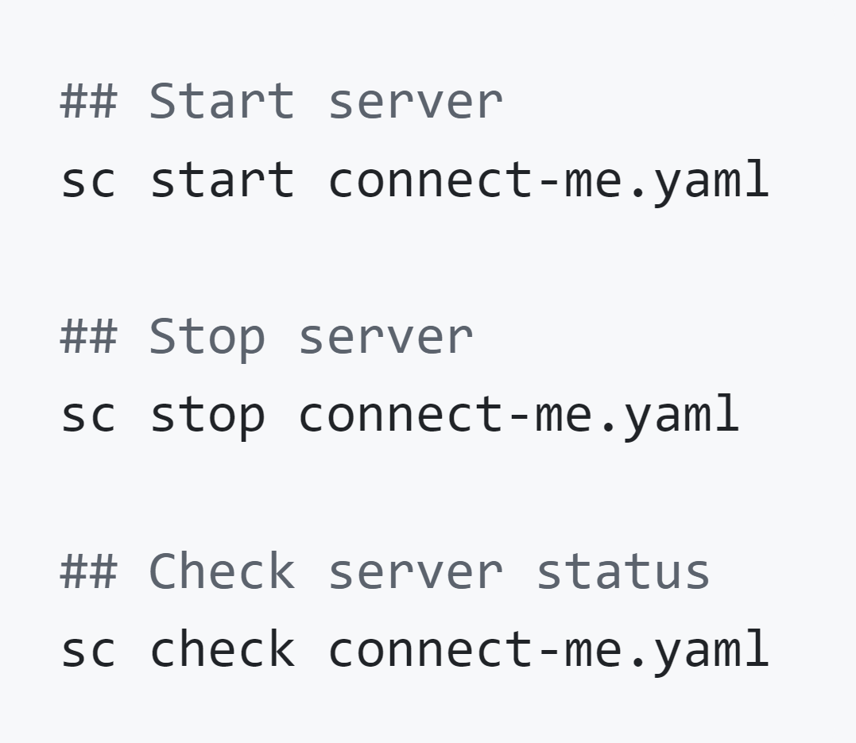
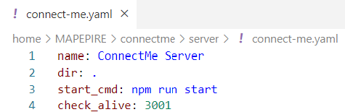
Create Service Commander Definition to Start Server
Service Commander A utility for managing services and applications running on IBM i

Slide 33
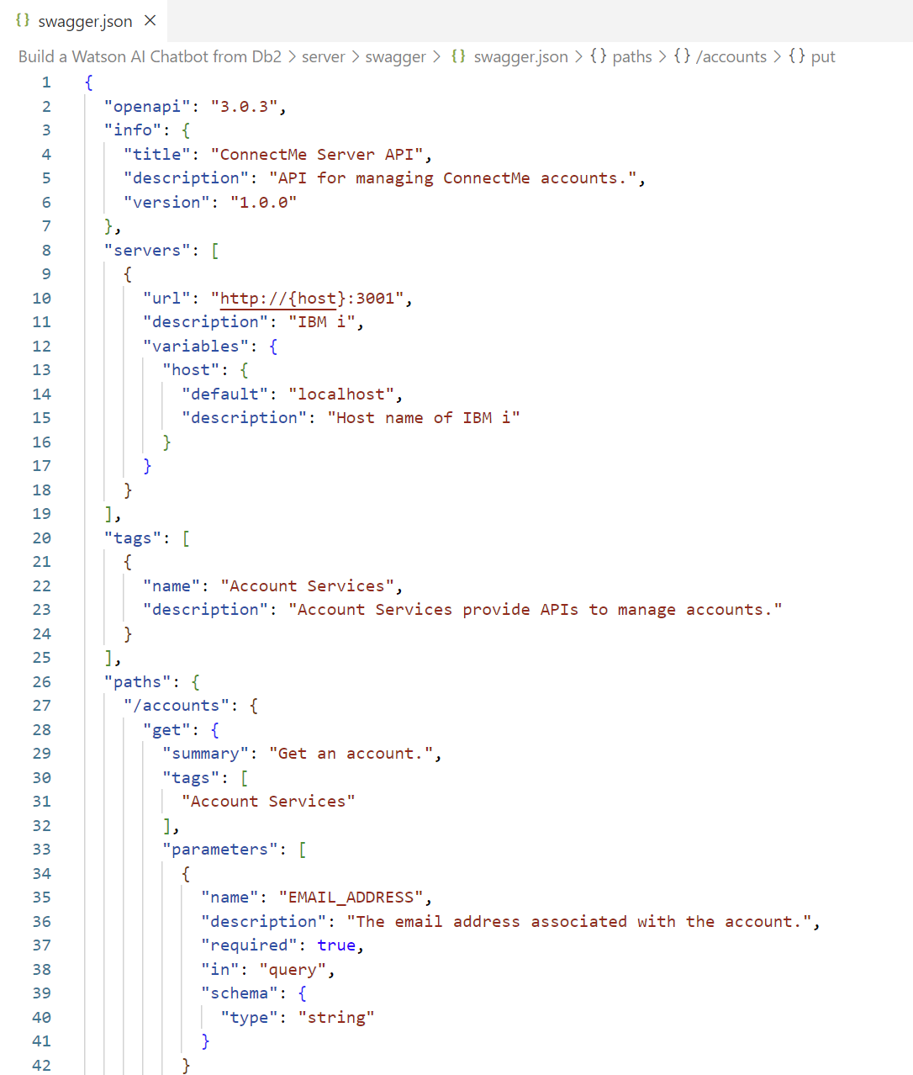
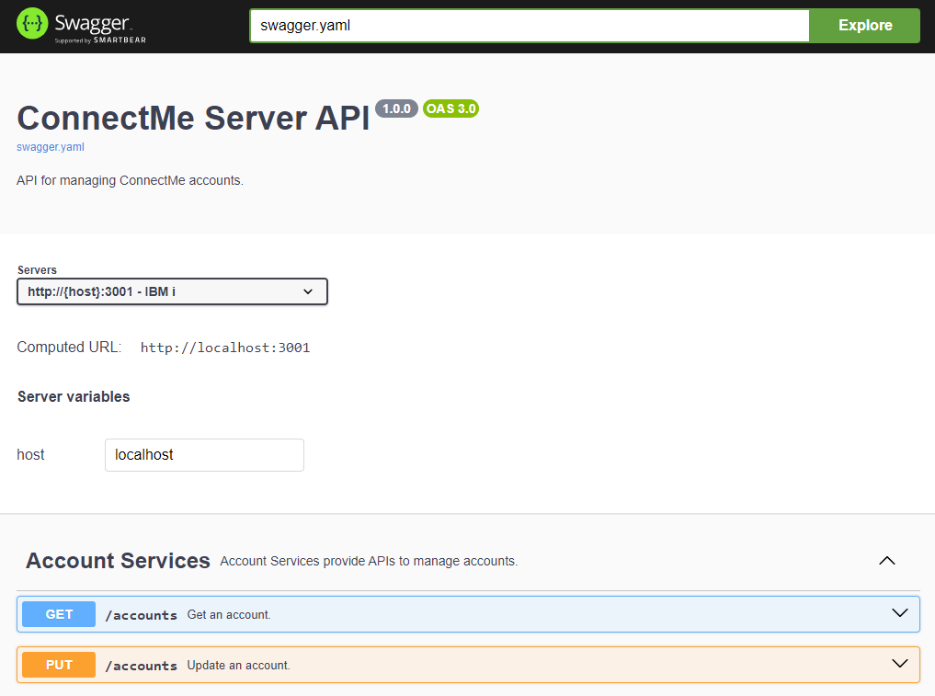
Create OpenAPI Specification (in JSON format)

Slide 34
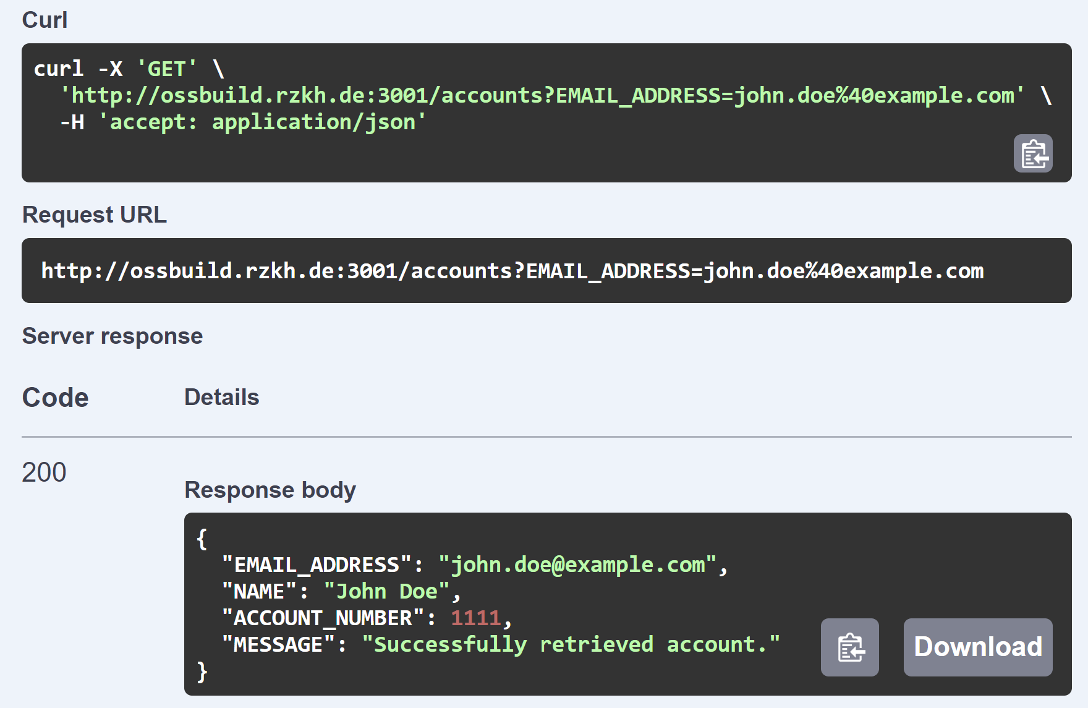
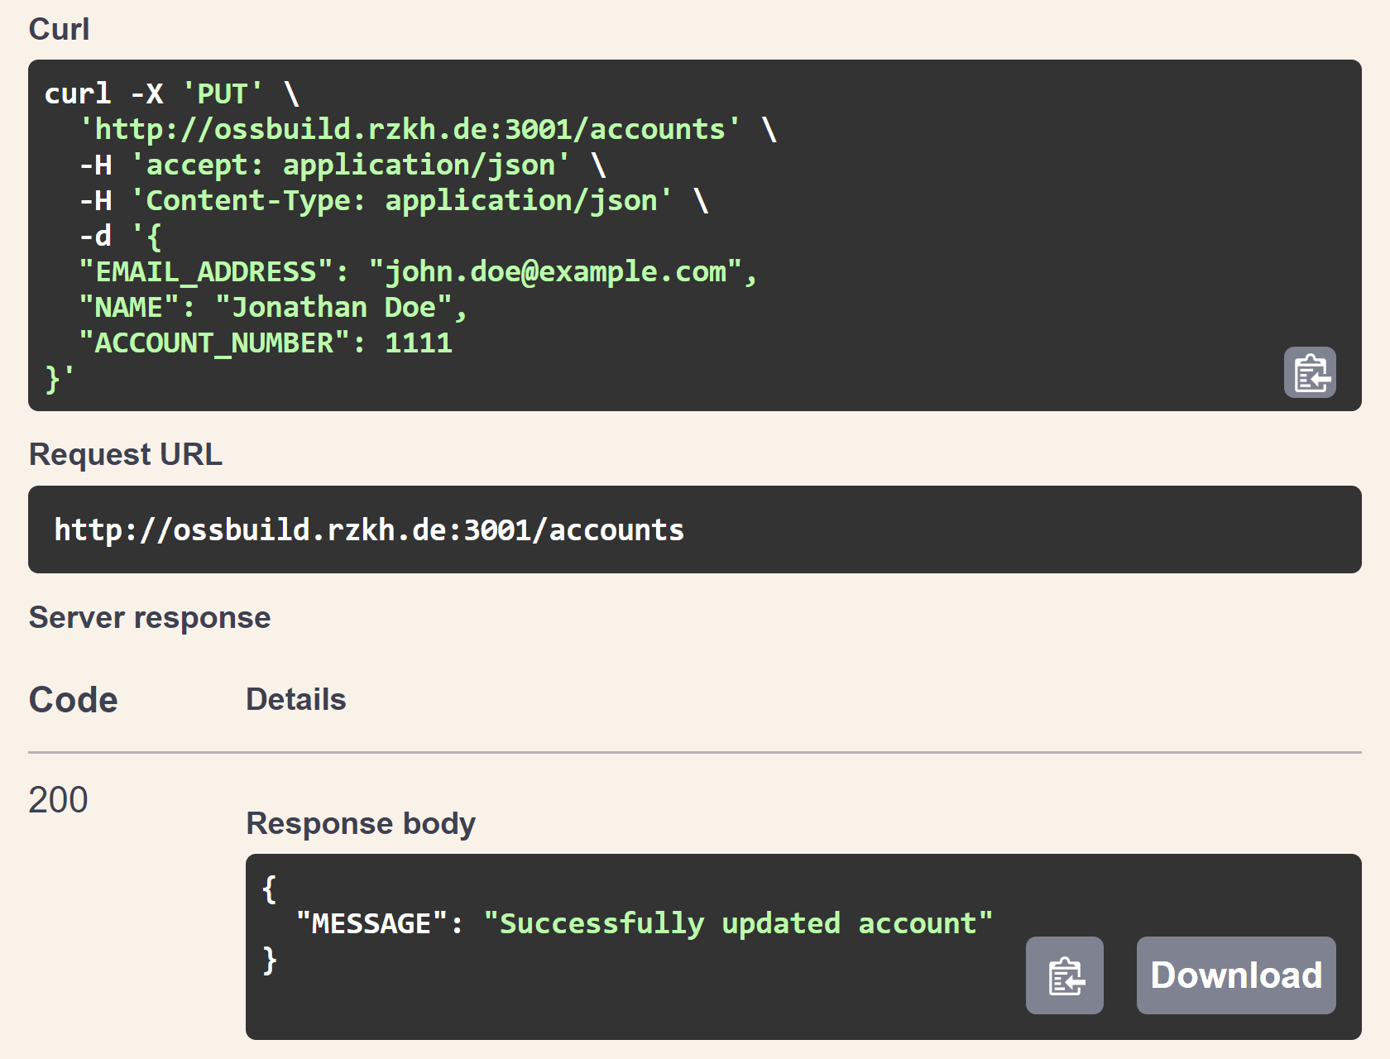
Test OpenAPI Specification

Slide 35
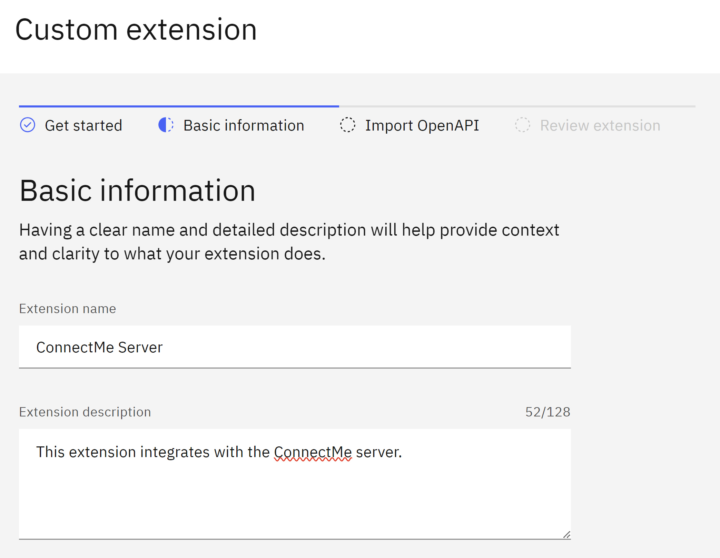
Build Custom Extension in Catelog

Slide 36
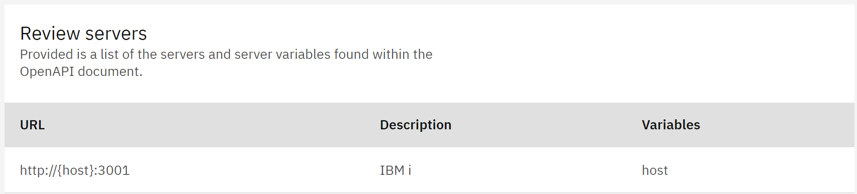
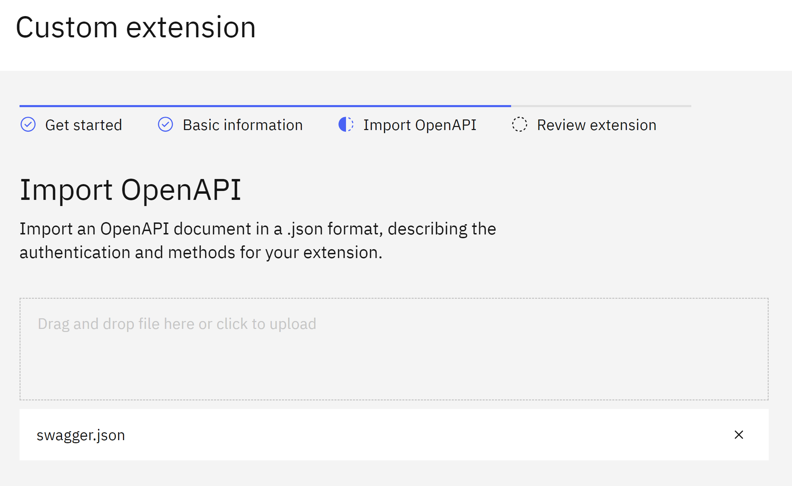
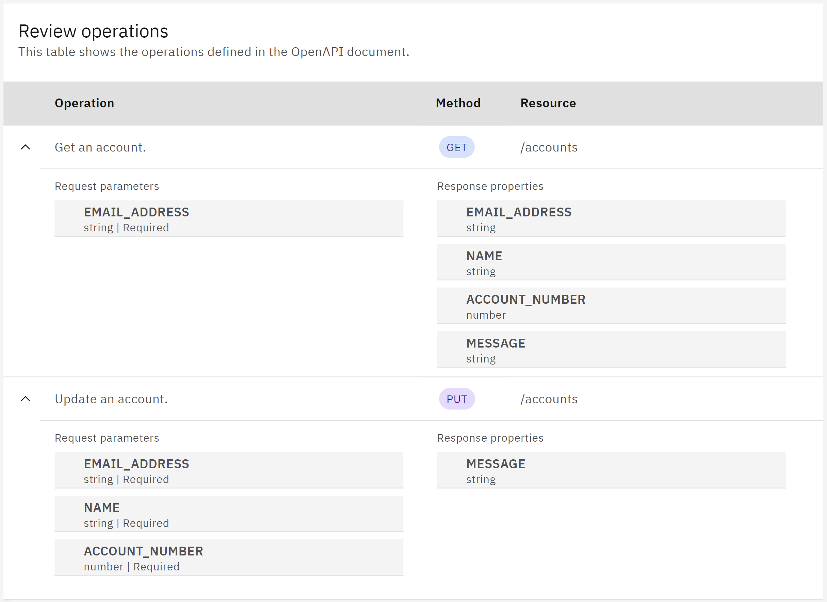
Import OpenAPI Specification

Slide 37
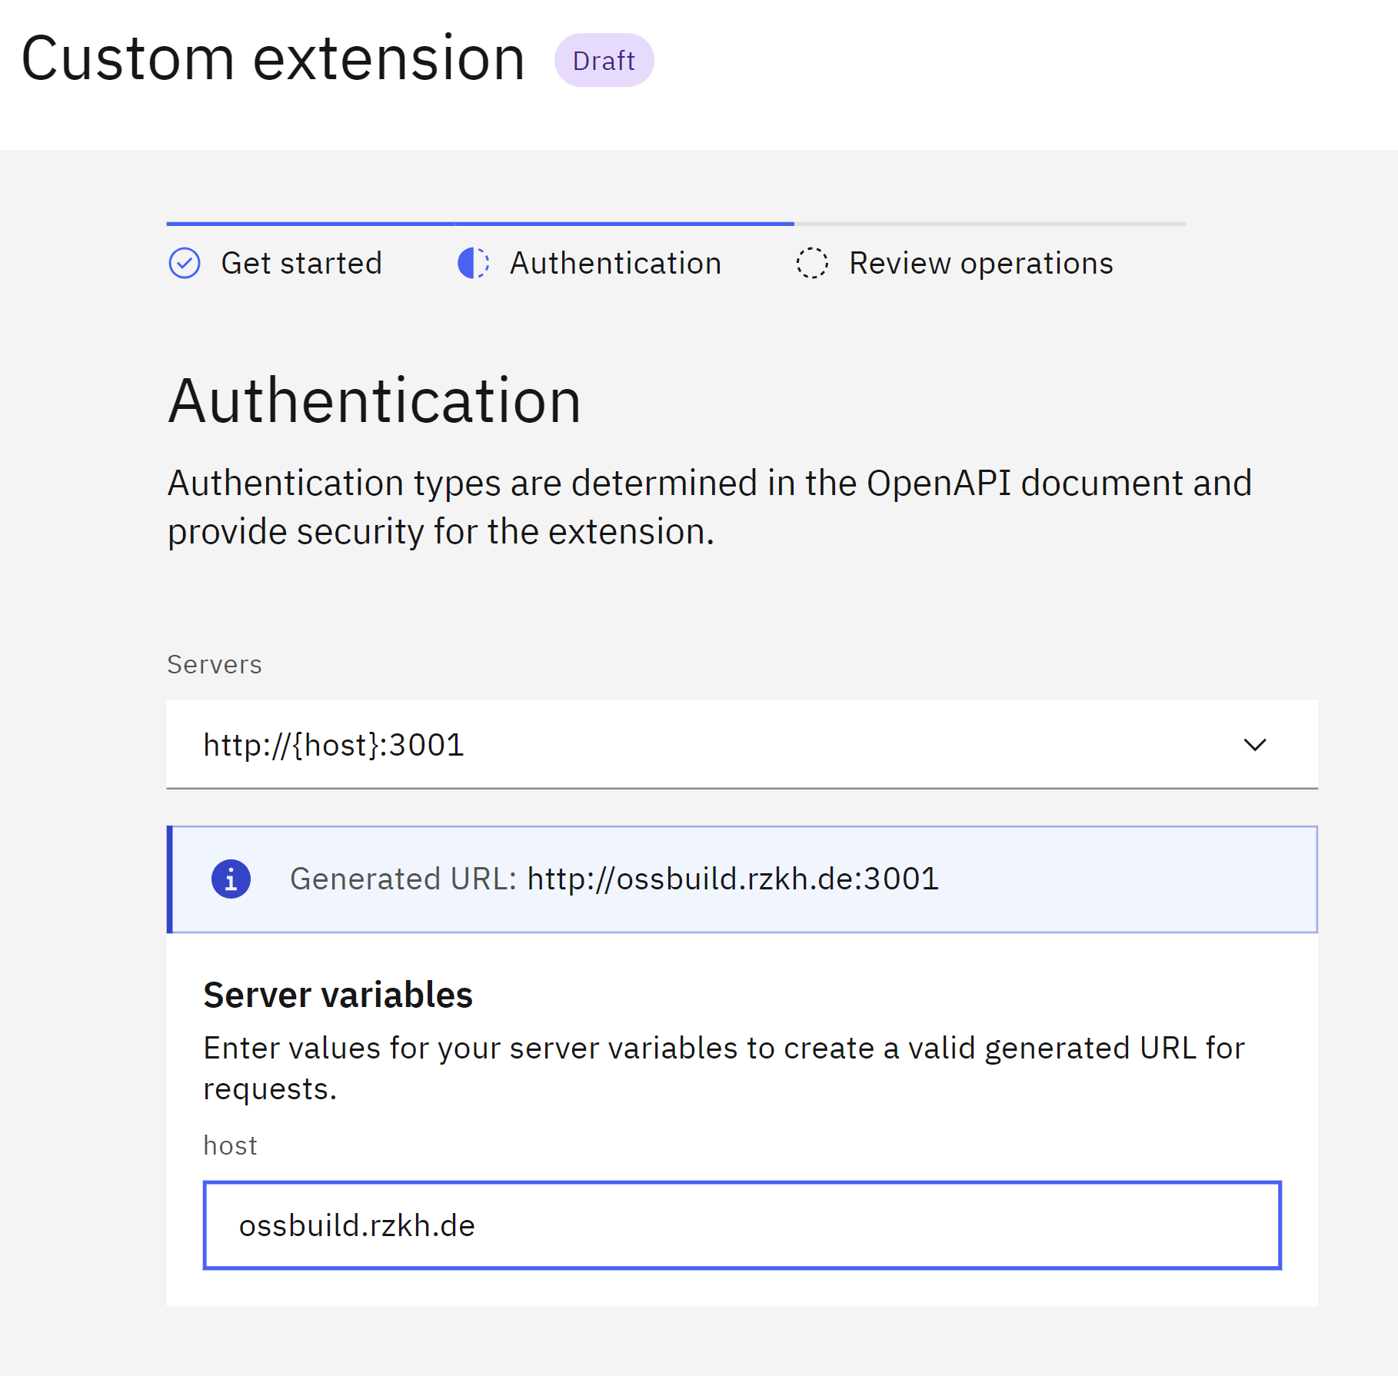
Add Extension to Watsonx Assistant

Slide 38
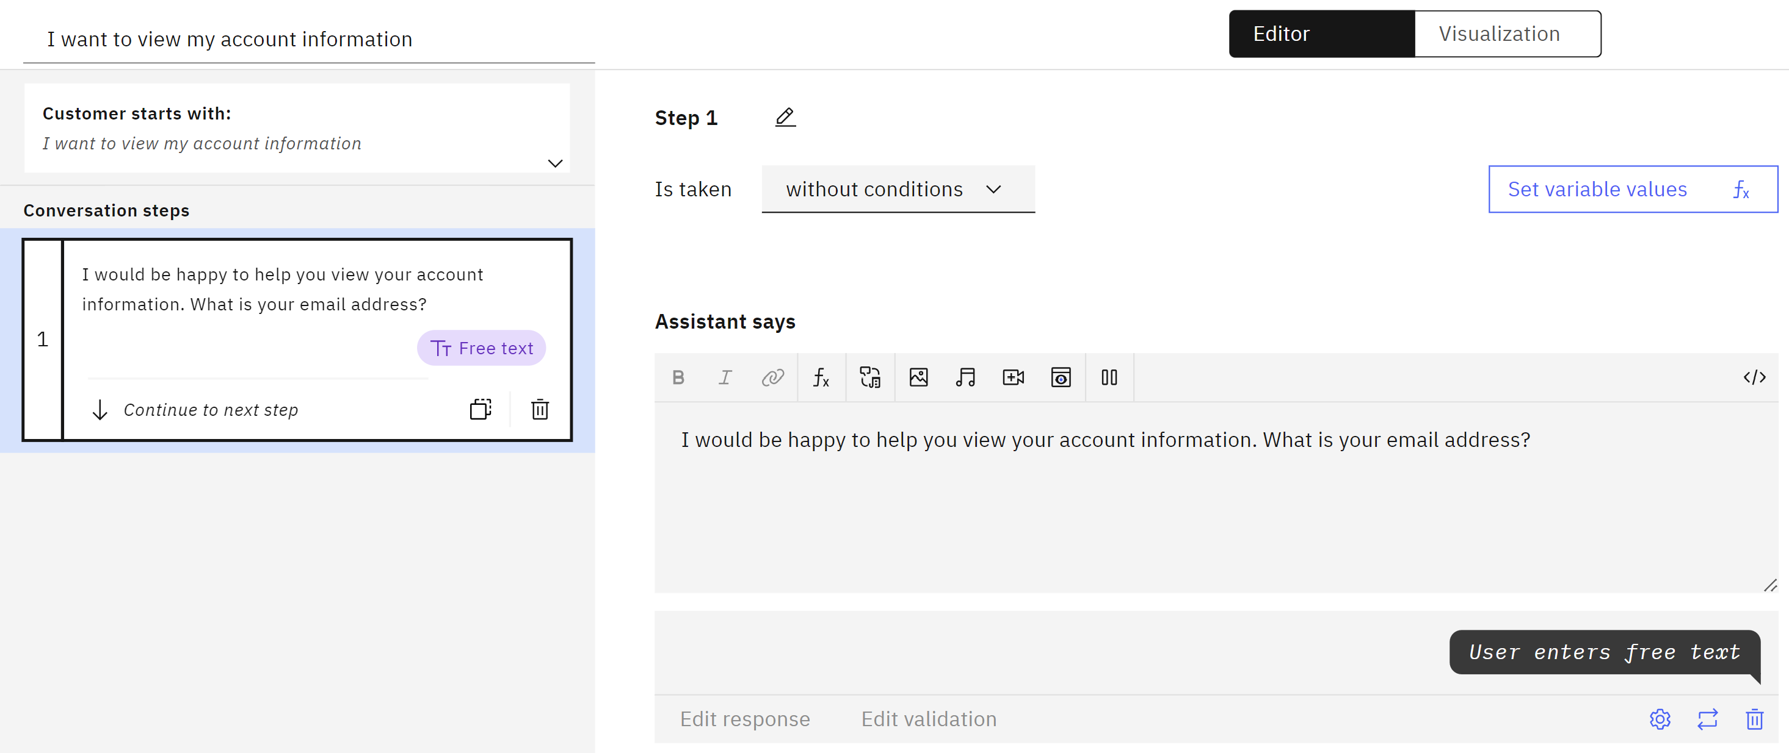
Create New Action with Initial Step

Slide 39
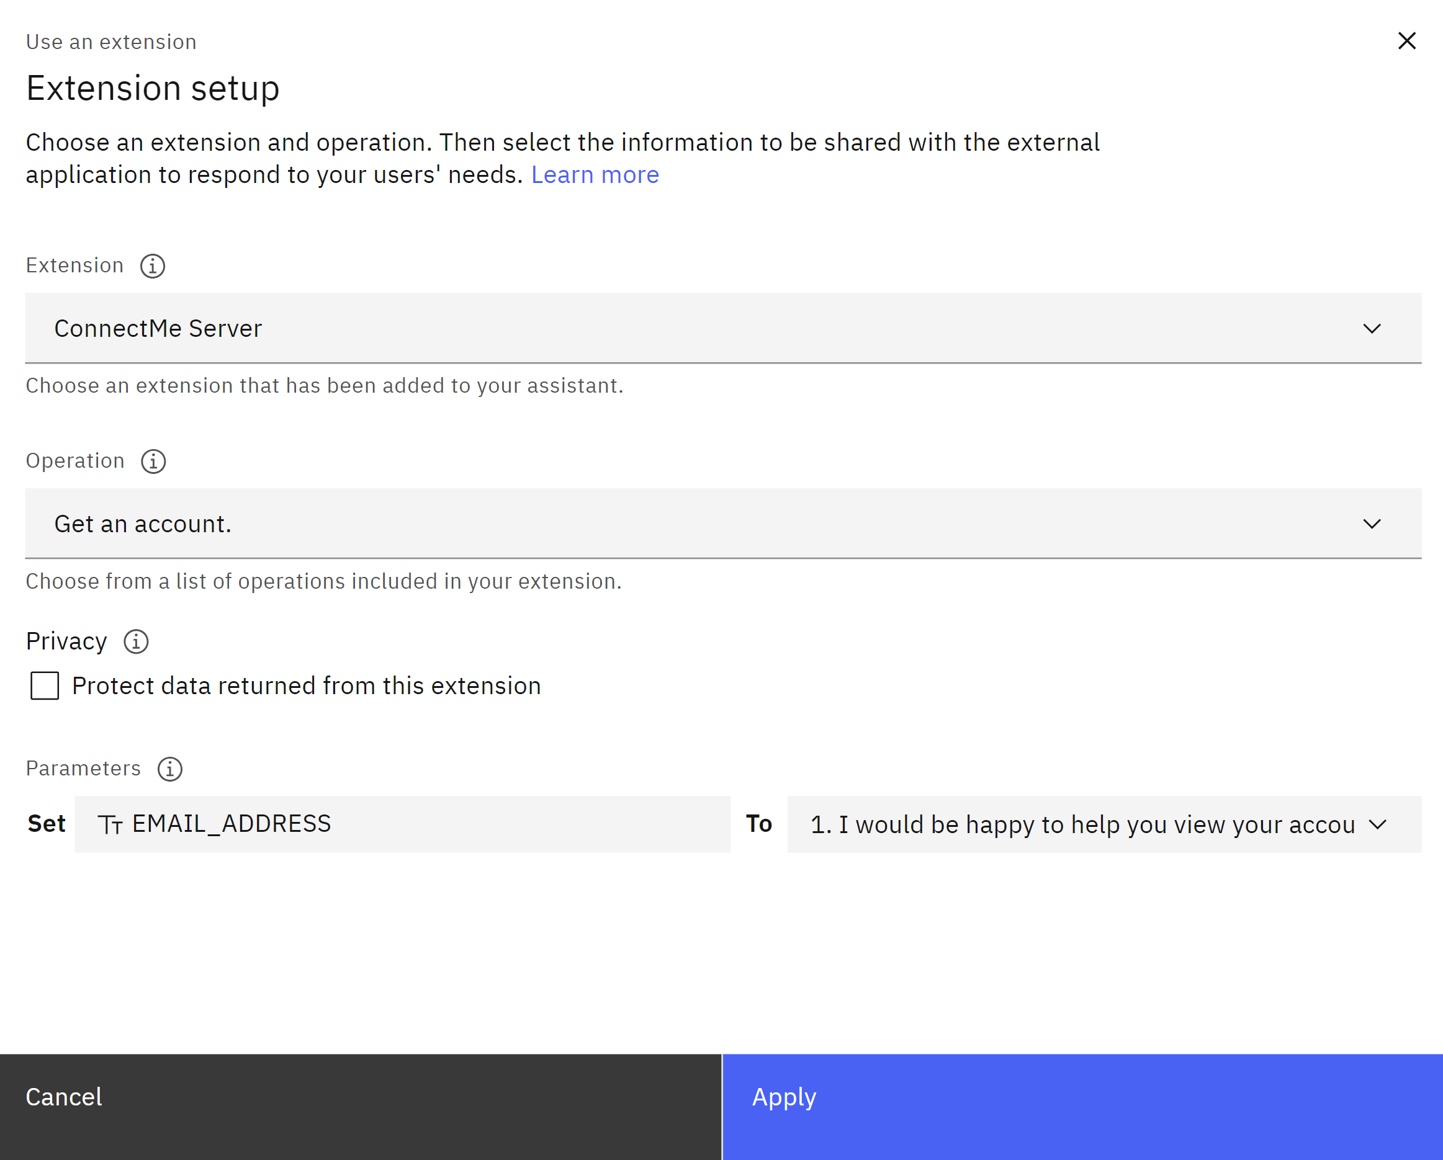
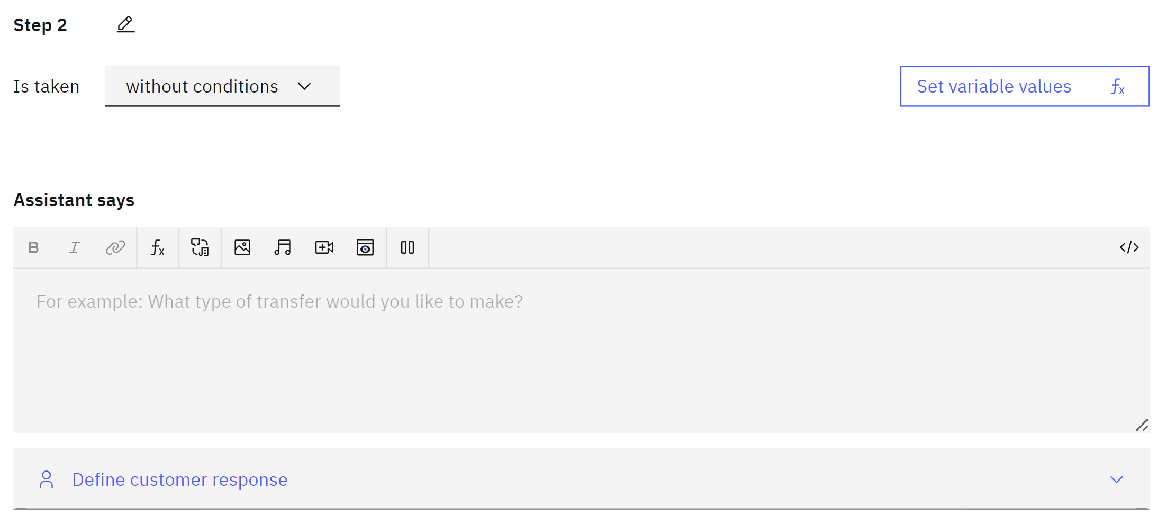
Create Step with Extension

Slide 40
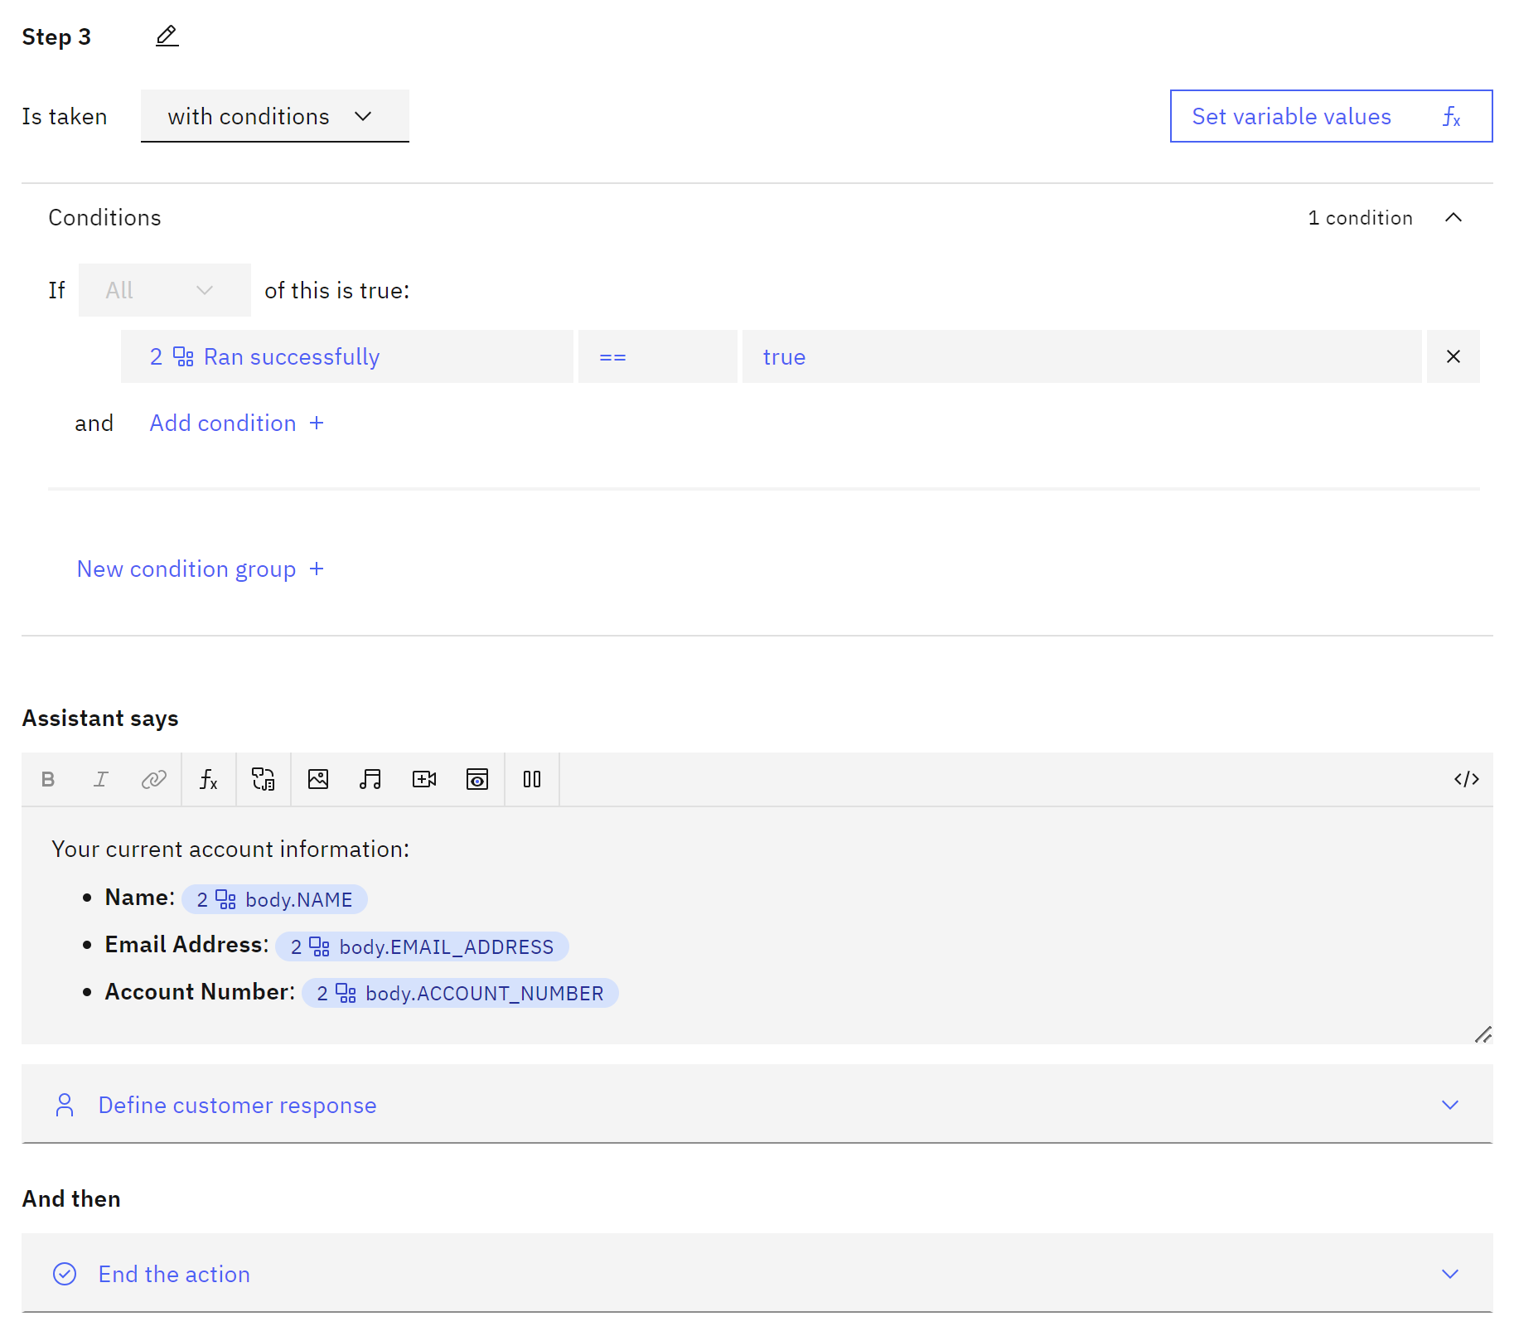
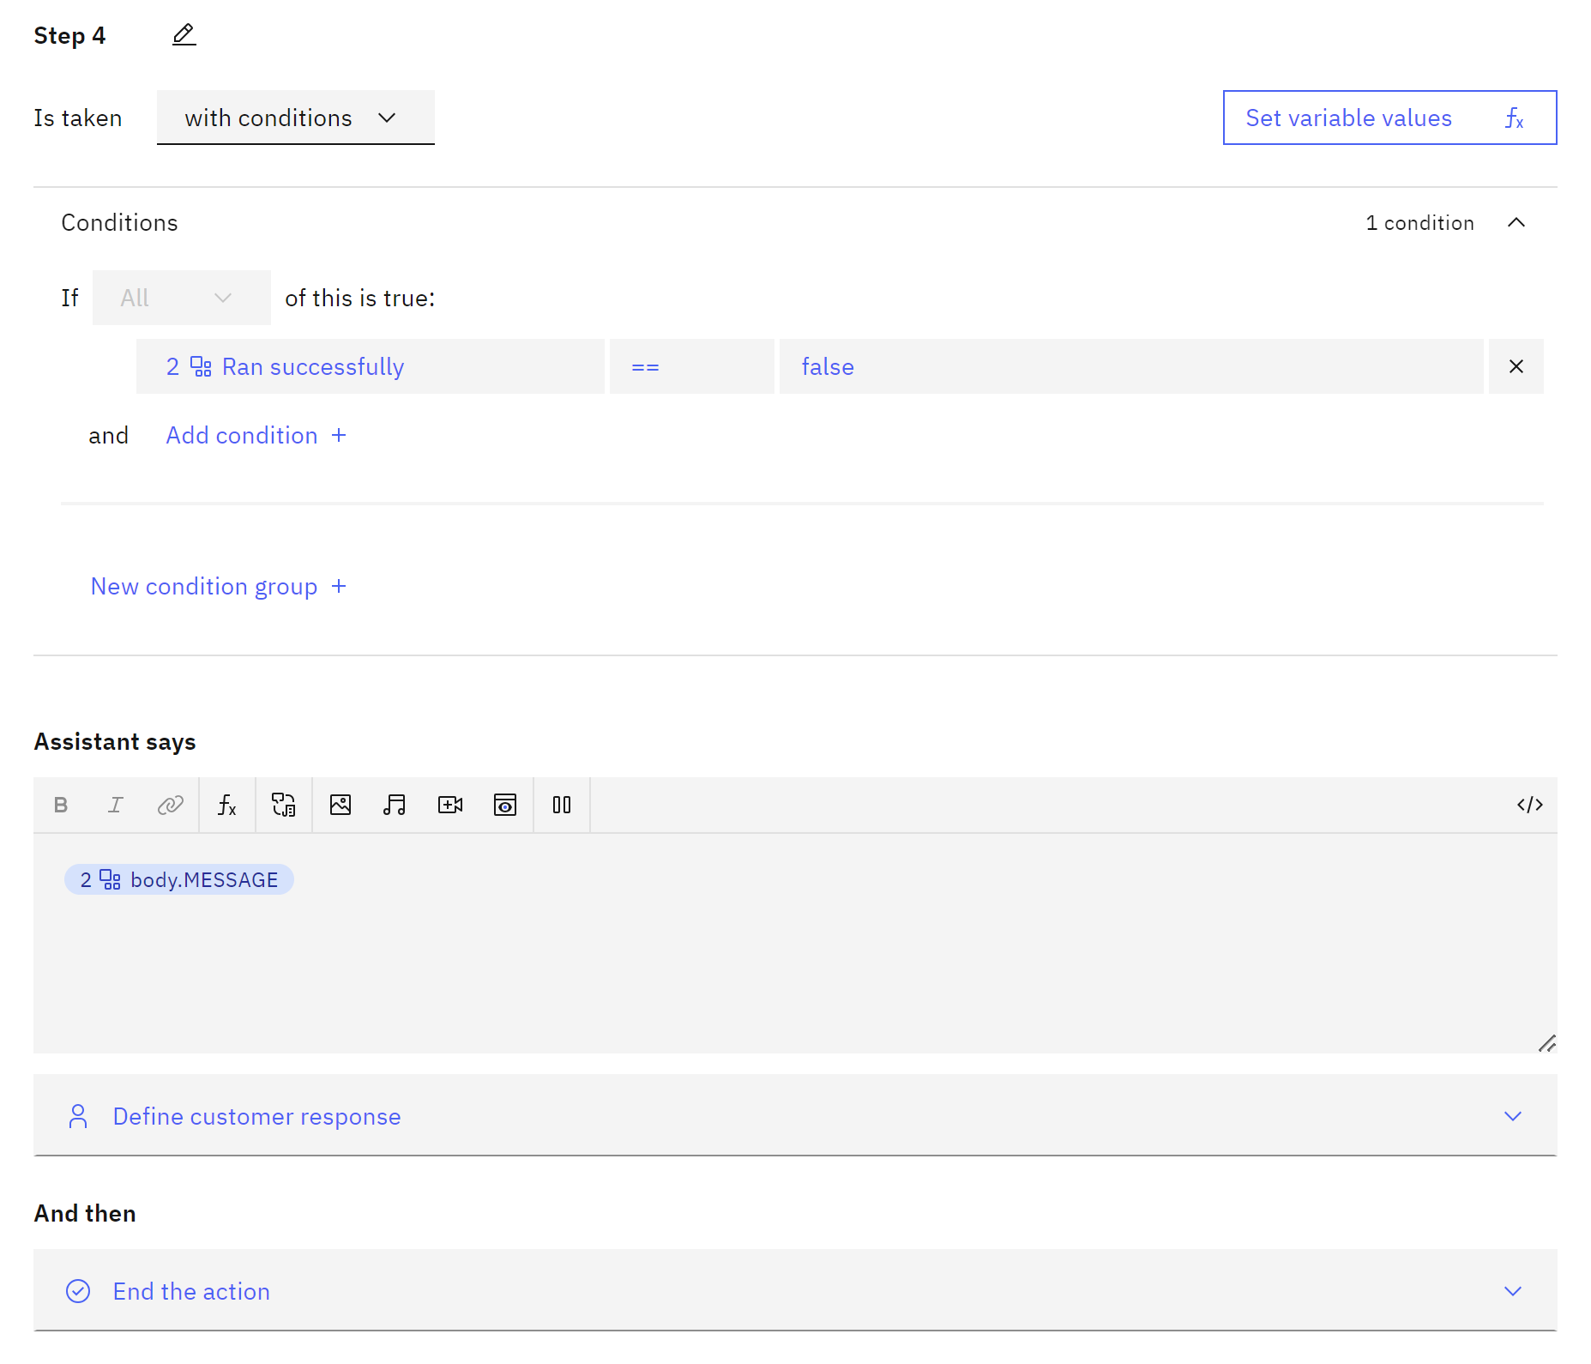
Create Success and Failure Steps
Extension Success
Extension Failure

Slide 41
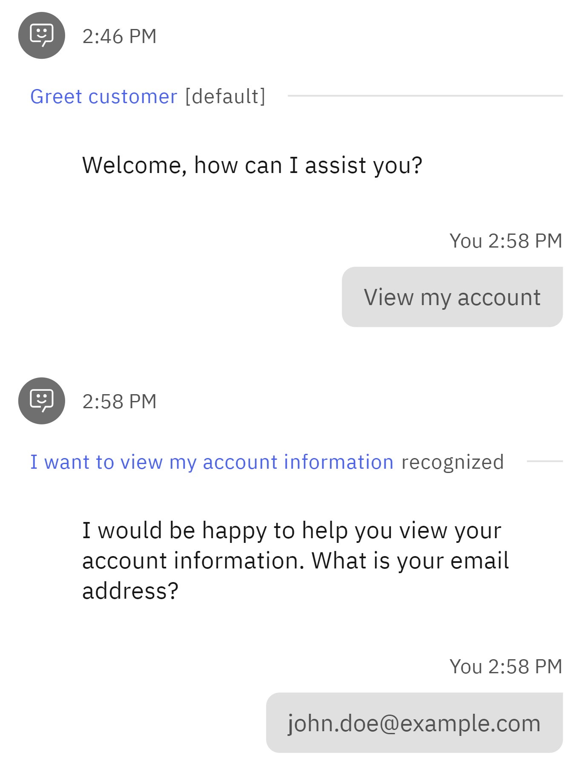

Preview Your Action

Slide 42


Duplicate Action and Update Phrase + Initial Step

Slide 43

Create Clarification Step

Slide 44


Create Step with Extension

Slide 45

Create Final Step

Slide 46



Preview Your Action

Slide 47
Next Steps

Slide 48

Add More Actions with Templates

Slide 49

Adjust Default Actions

Slide 50



Adjust Global Settings
Clarifying Questions
Show options when multiple actions seem to match what the customer wants
Change Conversation Topics Switch to other actions when customers ask about other topics
Intelligent Information Gathering The assistant retrieves and uses prior inputs to streamline the conversation

Slide 51



Search Integration with Watson Discovery
Search Integration Extend the scope of what your assistant can answer by searching documents and websites.

Slide 52
Any Questions?

Slide 53
Important Links
IBM Watsonx Assistant
Documentation https://cloud.ibm.com/docs/watson-assistant
ConnectMe Demo Source
SQL Account Table account.sql
REST Server server.js
OpenAPI Specification swagger.json
Service Commander
Documentation https://github.com/ThePrez/ServiceCommander-IBMi

Slide 54

For More Information
Links You Need | Twitter | #Hashtags
IBM i Home Page: https://www.ibm.com/it-infrastructure/power/os/ibm-i (find link to Forrester Study and updated IBM i Strategy Whitepaper) IBM Strategy Whitepaper: https://www.ibm.com/it-infrastructure/us-en/resources/power/i-strategy-roadmap/ IBM Client Success: https://www.ibm.com/it-infrastructure/us-en/resources/power/ibm-i-customer-stories/ Support Life Cycle: https://www.ibm.com/support/lifecycle/ License Topics: https://www-01.ibm.com/support/docview.wss?uid=nas8N1022087 Fortra IBM i Marketplace Survey https://www.fortra.com/resources/guides/ibm-i-marketplace-survey-results | @IBMSystems @COMMONug @IBMChampions @IBMSystemsISVs @IBMiMag @ITJungleNews @SAPonIBMi @SiDforIBMi | #PowerSystems #IBMi #IBMAIX #POWER9 #LinuxonPower #OpenPOWER #HANAonPower #ITinfrastructure #OpenSource #HybridCloud #BigData

Slide 55

Build a Watson AI Chatbot from Db2 - Sanjula Ganepola
Please take the last minute of this session to complete the evaluation. A direct link to the evaluation can be found using the QR code below.

